Slide 1
Industry Challenge Presentation Healthcare Atlanta Abby Couvillon, Drew Paschal, George Jeno, Praveen Balaji
August 8, 2019

Slide 2
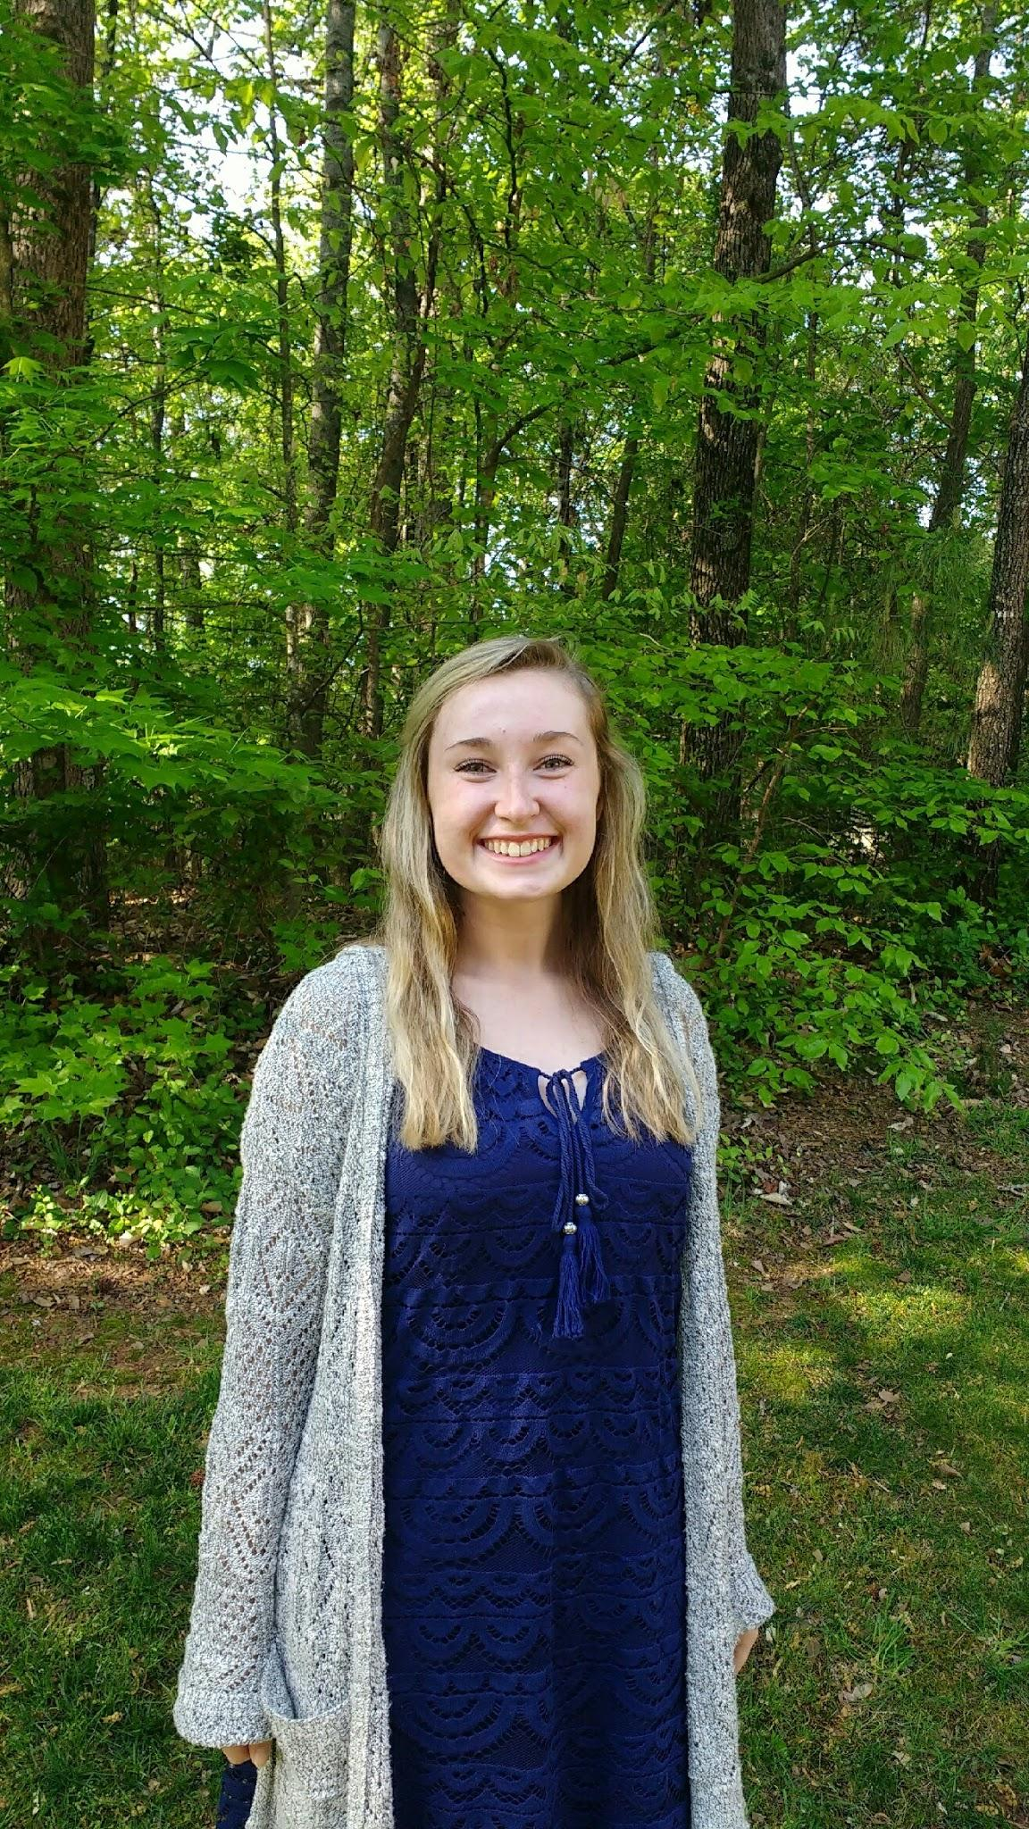

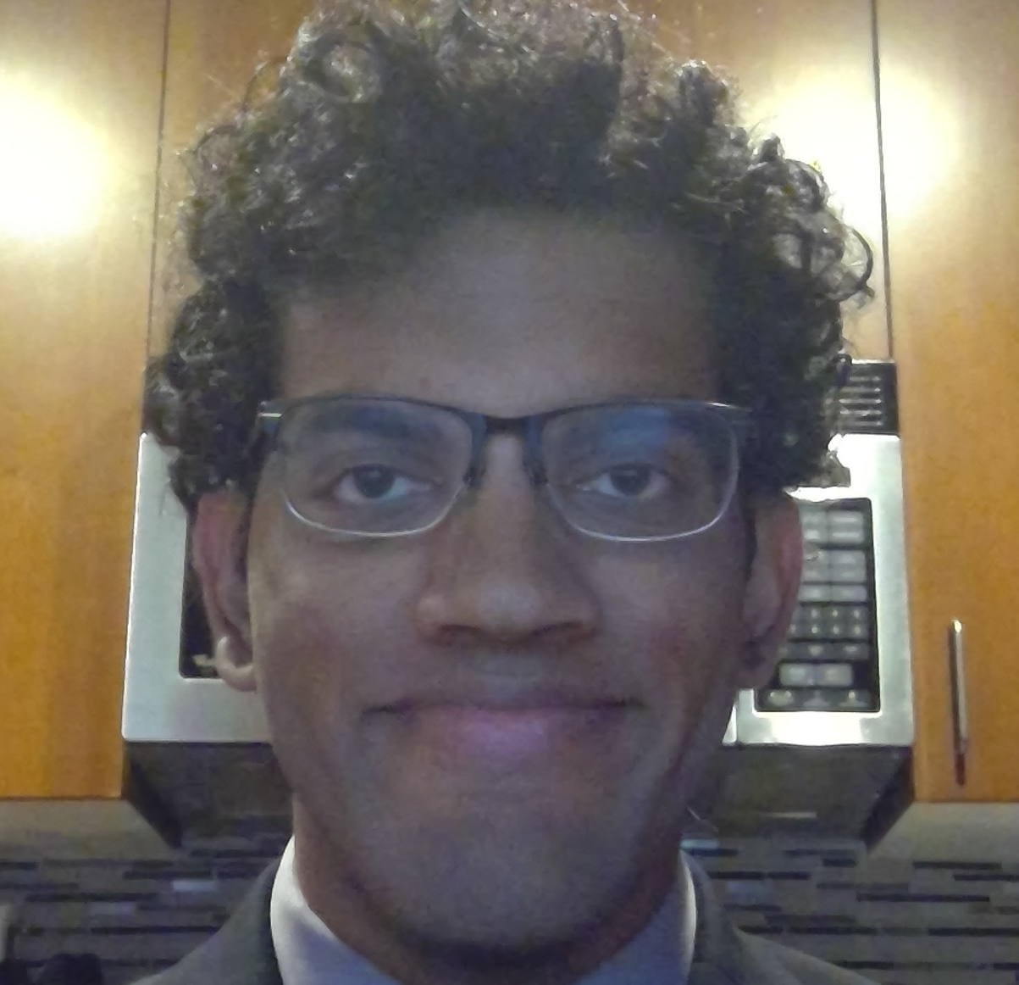
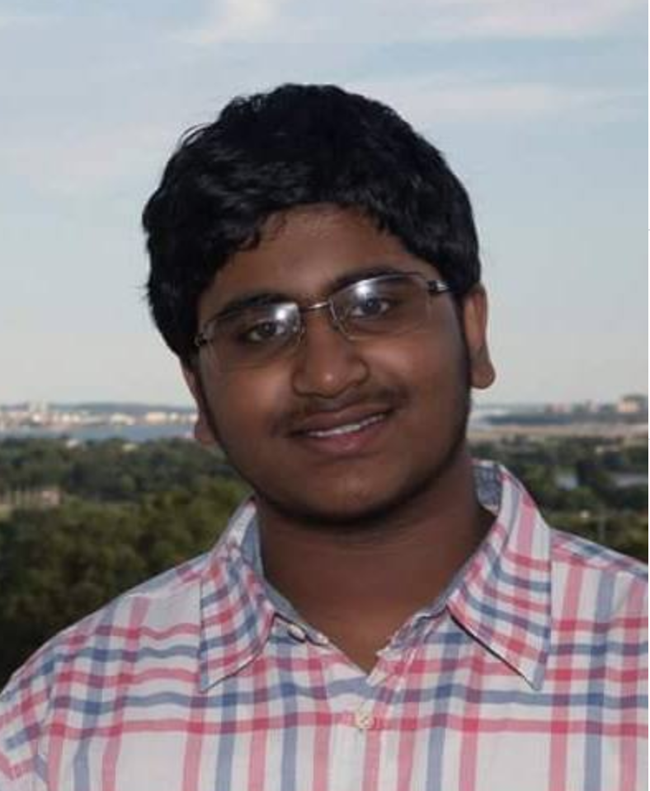
Meet the Team
Abigail Couvillon
Drew Paschal
George Jeno
Praveen Balaji

Slide 3
Table of Contents
Industry Challenge
What do we need?
Our Approach
Future Usage
Reflection

Slide 4
Section 1
Industry Challenge

Slide 5

HEALTHCARE – DECREASING MEDICAL NON-ADHERENCE
Medication non-adherence has an estimated cost to the US health system of $290 B. The human cost comes in the form of a lower quality of living and lives cut short. Improving adherence is difficult because there are many reasons for non-adherence, which vary based on socioeconomic factors, demographics, medical condition, medication regimen, and the individual person.
How can we begin to address the challenge of adherence by exploring technical point solutions that can combine into an ecosystem of complementary offerings tailored to a specific patient?

Slide 6
Medication nonadherence is a multifaceted and complex problem.

Slide 7
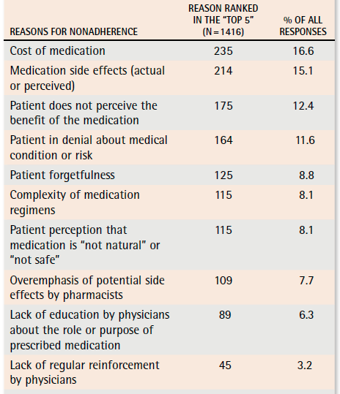
Medication nonadherence is a multifaceted and complex problem.
A robust means of measuring adherence is necessary to track the effectiveness of any solution and adjust the approach per-patient
Table taken from https://www.ncbi.nlm.nih.gov/pmc/articles/PMC2793205/

Slide 8
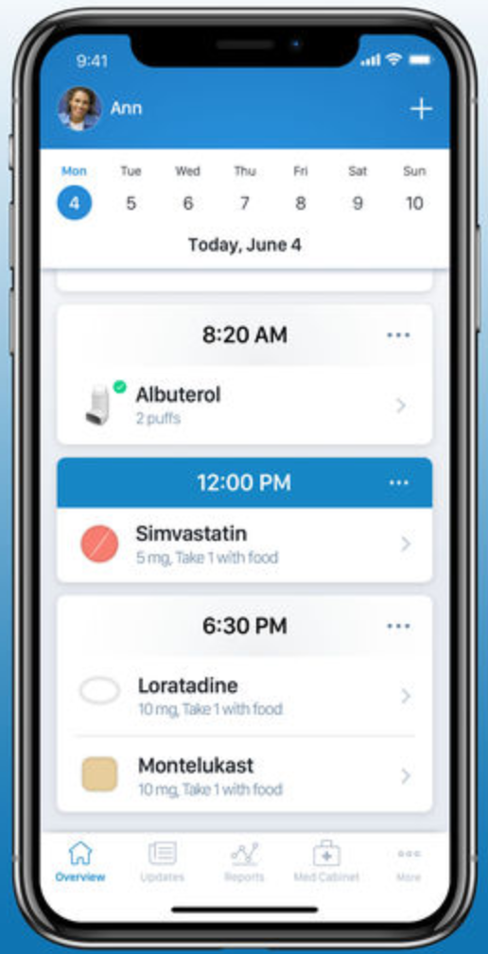
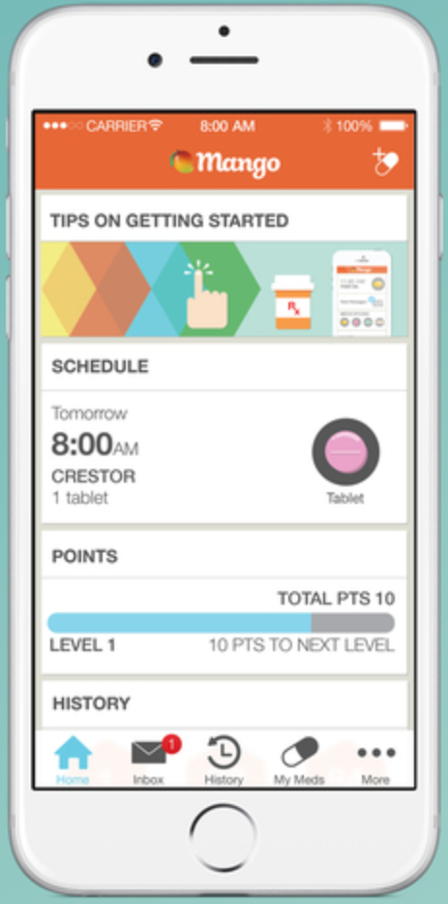
Reminder apps alone are not enough

Slide 9
Section 2
What do we need?

Slide 10
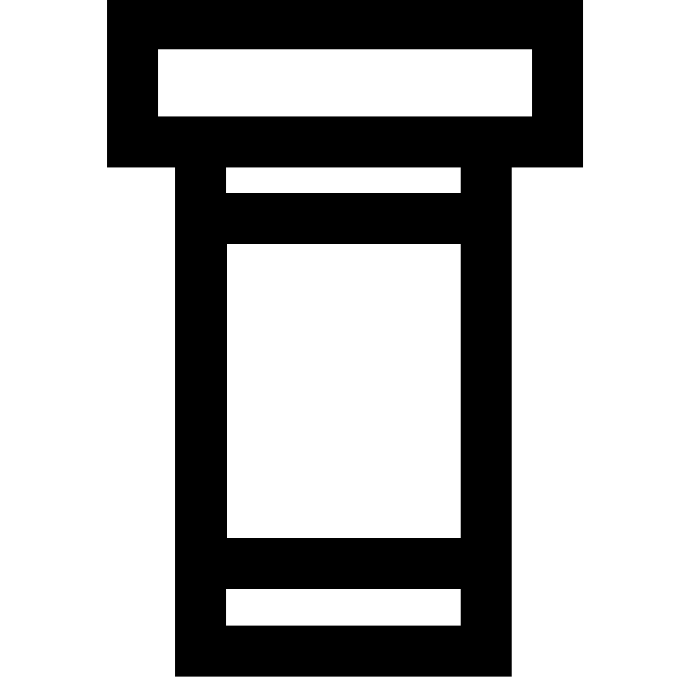

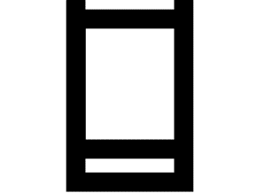
How can we effectively measure adherence and use this data to lower nonadherence rates?

Slide 11
“Nearly 70 percent of Americans are on at least one prescription drug, and more than half take two… Twenty percent of patients are on five or more prescription medications…” ¹
Mayo Clinic, 2013

Slide 12
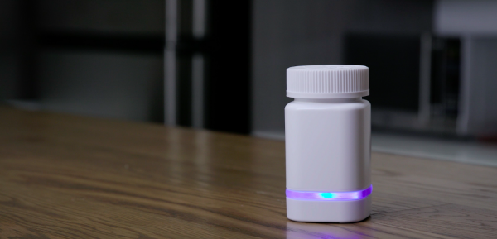
Existing Solutions and Issues with Solutions
Solution: AdhereTech has developed a smart pill bottle which can detect when the cap is taken off and put back on.
Issue: For a user to fully use smart pill bottles with their medications, they would need to purchase a separate smart bottle for each medication.
$1000/year per bottle ²
# of different medications?

Slide 13
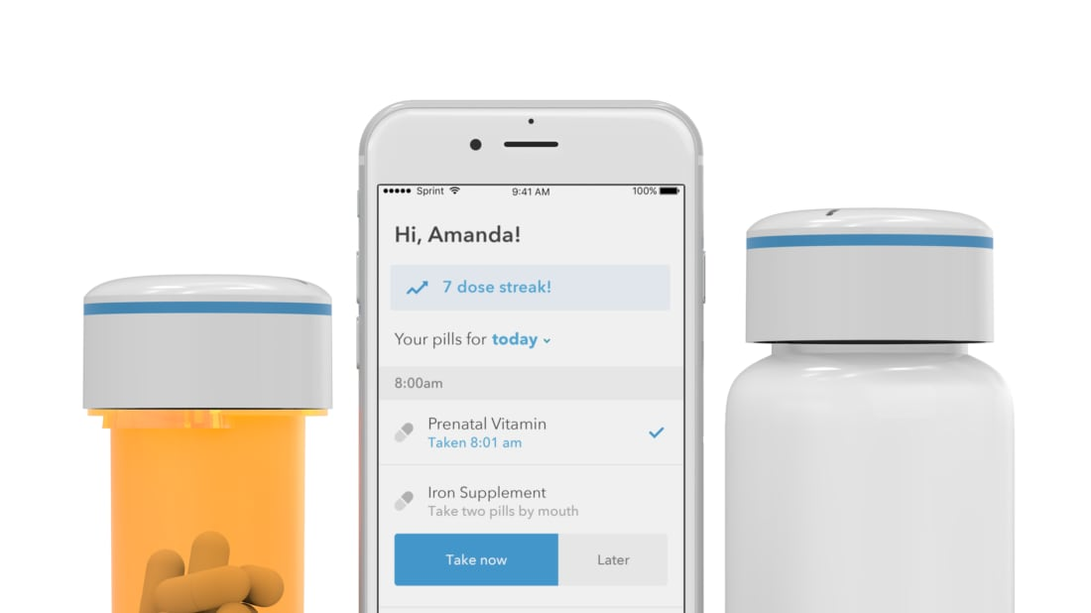
Existing Solutions and Issues with Solutions
Solution: Pillsy utilizes smart bottle caps to determine when a bottle is opened and closed, and integrates with an app to give reminders to the user.
Issue: This approach similarly requires the user to at least purchase one smart cap for each medication they take - a different bottle form factor could also require the purchase of a new bottle.
~$40 per cap/bottle ³

Slide 14
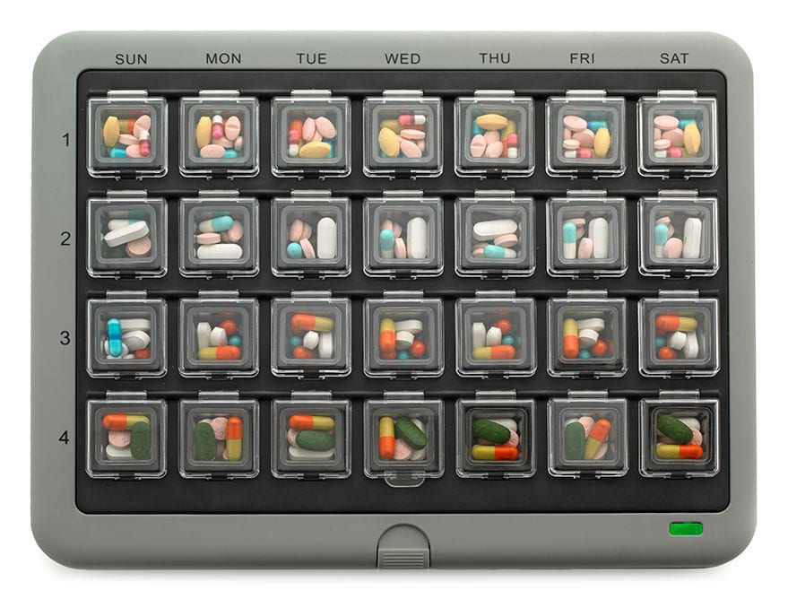
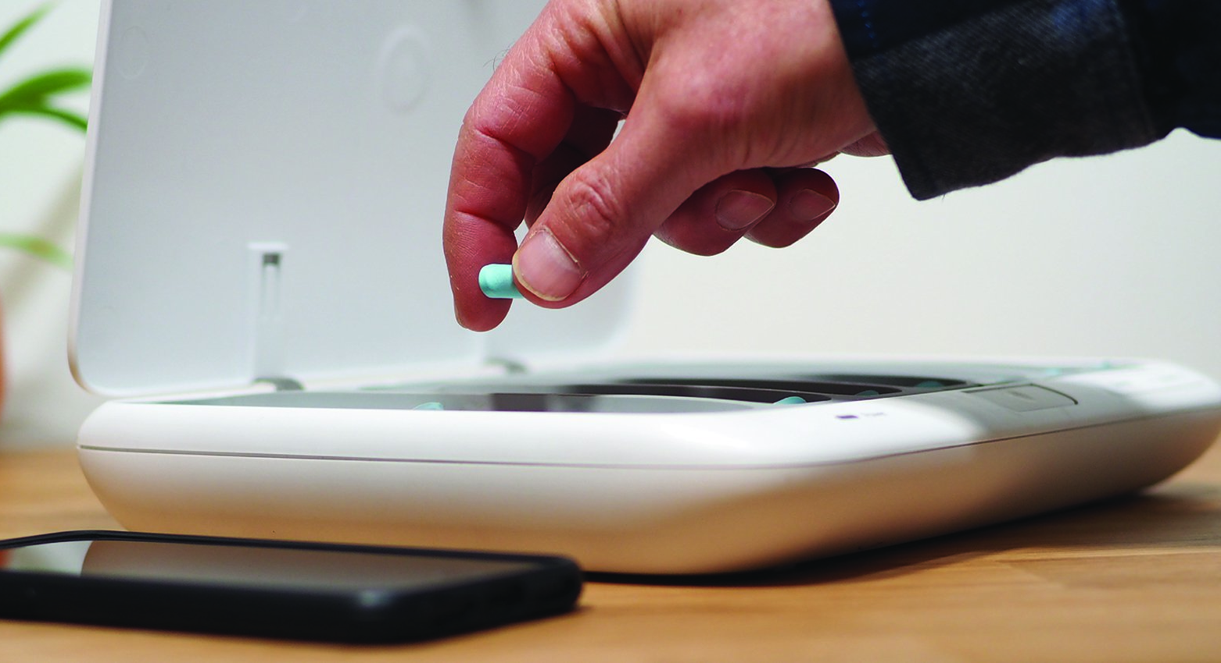
Existing Solutions and Issues with Solutions
Solution: Various companies such as TowerView and MedMinder have developed smart pill organizers, which group medications based on the day and time they should be taken, with reminder systems for the designated times.
Issue: Smart organizers which have the user do the initial organization can be too tedious to use, and higher-end smart organizers may be prohibitively expensive for the average target user.
TowerView: $399 to purchase ⁴
MedMinder

Slide 15
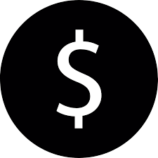

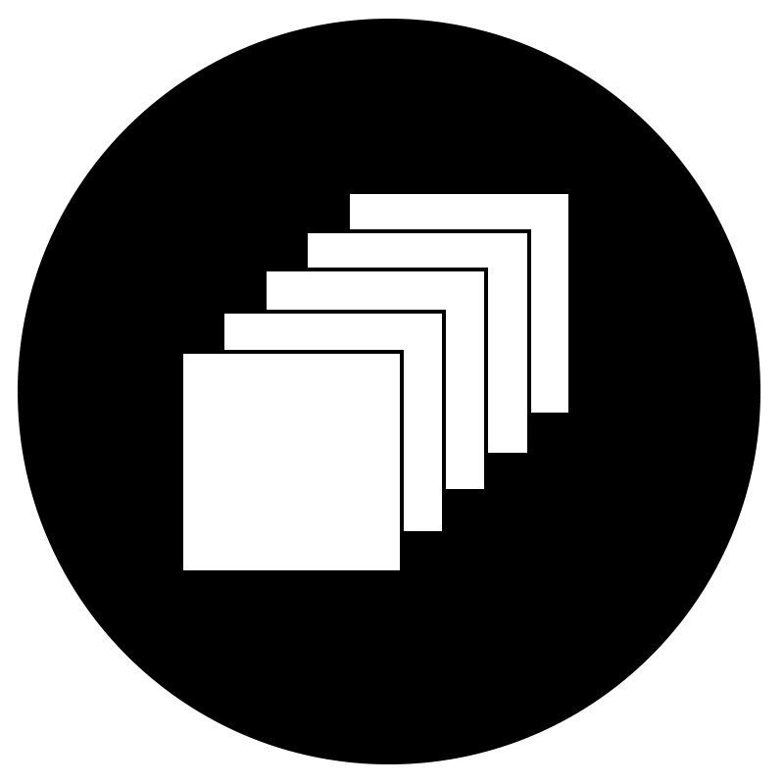
What qualities are necessary in a solution?
Non-prohibitive Price
Ease of Use
Our solution takes all three into account
Scalability

Slide 16
Section 3
Our Solution

Slide 17
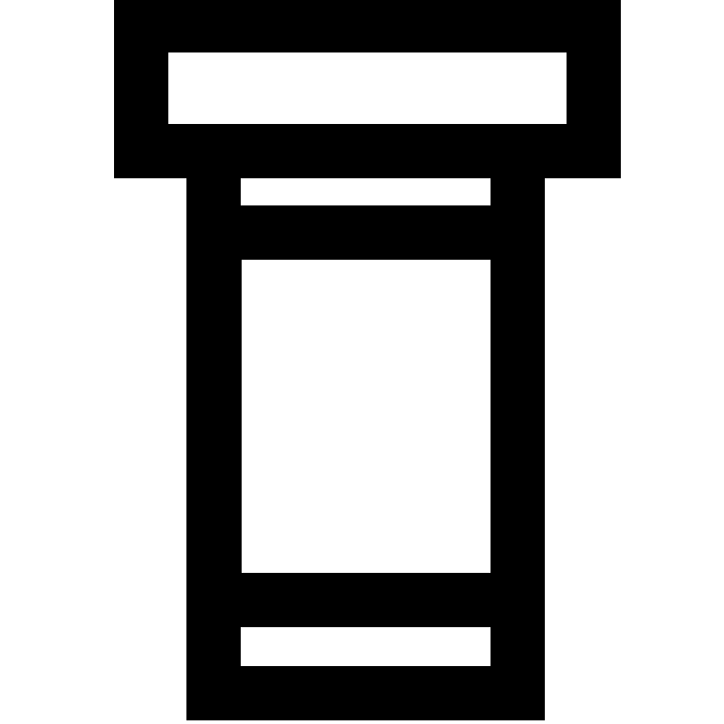

Solution Components
Modified Pill Bottles
Camera + Processor Unit
Detection Component
Update Database
Update Application Info
Update Database
Application Component

Slide 18
Addressing Problem
Detection Component
Low-cost components allow for an affordable selling price
After initial setup, no extra steps are required on the user’s side
Application Component
More medications can be added without the need to purchase additional hardware

Slide 19

Retroreflective Tape
Retroreflective tape

Slide 21
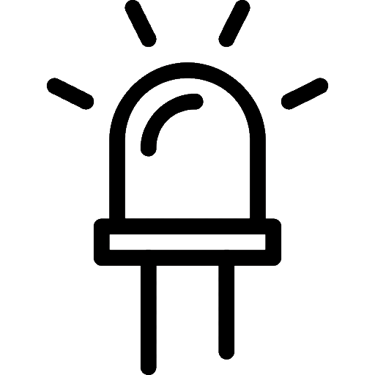


Hardware
Ambient Light Source
Direct Light Source
Raspberry Pi 2
USB Webcam

Slide 22
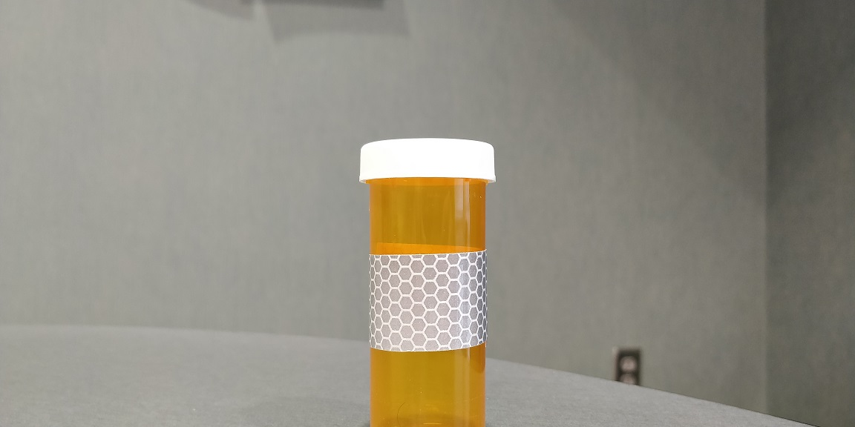
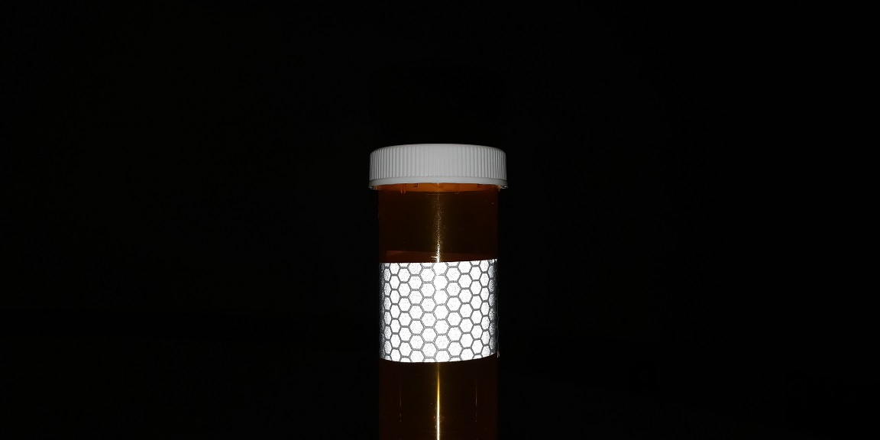
Hardware

Slide 23
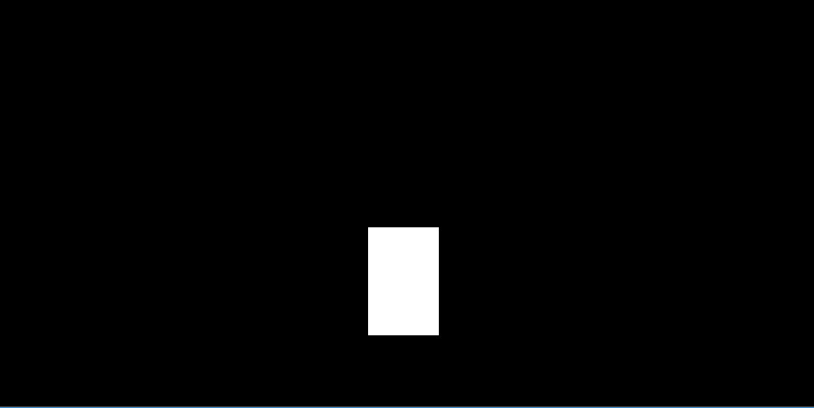
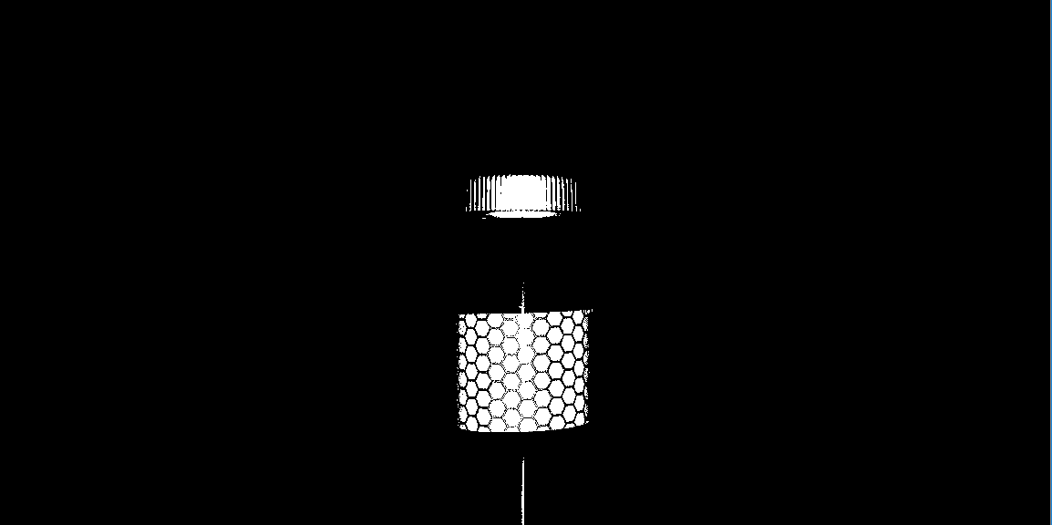
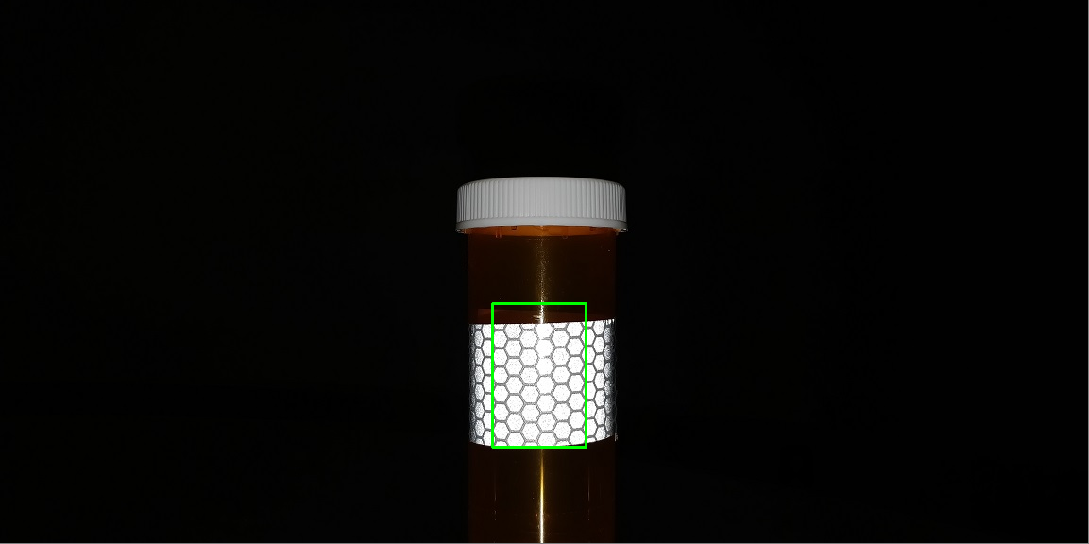
Computer Vision

Slide 24
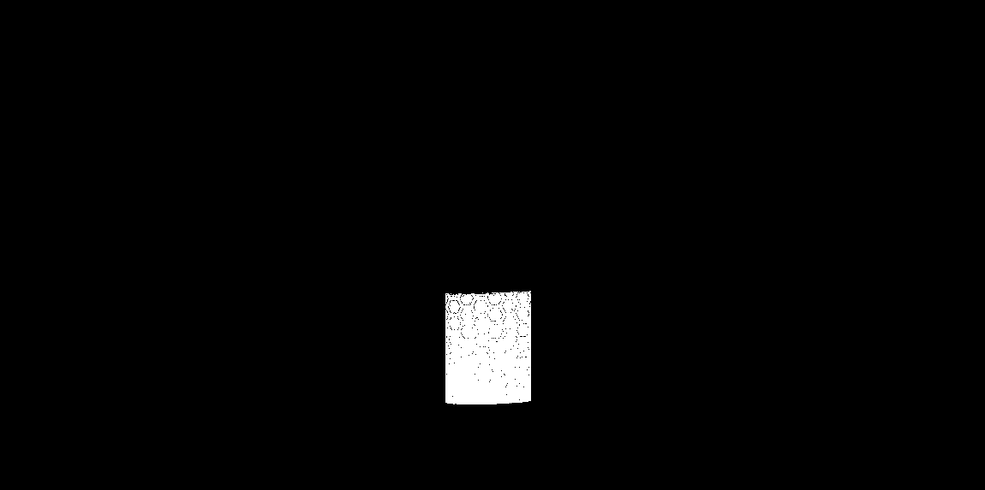
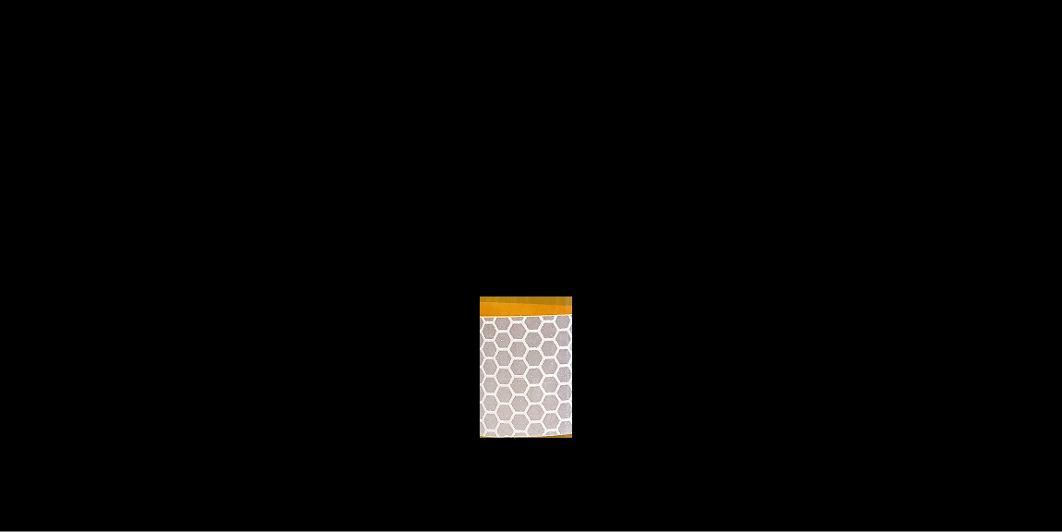
Computer Vision
(“white”, true)

Slide 25

Hardware - Server Interaction
POST Request
(color: yellow, id: #)
{(“red”, true), (“yellow”, false), (“white”, true)}

Slide 26
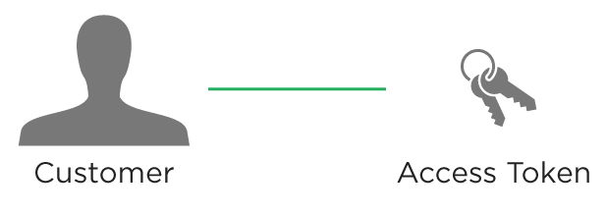
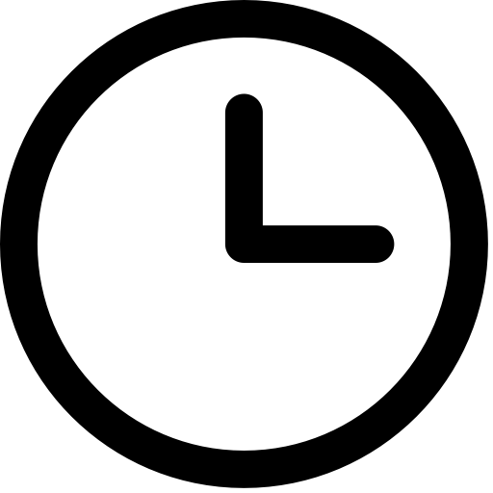



Server
Accessed using API
Security
Data stored in server

Slide 27

Application - Server Interaction
Update medication adherence information
Store user-generated data

Slide 28
Demo

Slide 29
Section 4
Future Usage

Slide 30
Usage as Part of Larger Ecosystem
Leveraging collected data for other applications
Adding additional app functionality for broader approach
Extra capabilities to enhance reminder system

Slide 31
Factors to be Addressed in Future
Not feasible for use by people who cannot consistently keep their medications on a flat surface with sufficient space, such as frequent travelers.
Not fully robust in measuring adherence; both accidental and purposeful movements of bottles without taking the medications can result in spurious adherence measurements.

Slide 32
Section 5
Reflection

Slide 33
Technical
Android app design & development
Server creation and API setup
Computer Vision using OpenCV
Development of physical build using Raspberry Pi 2

Slide 34
Procedural
Design -> implementation process
Working as a group: Brainstorming, division of labor
Reorientation of project

Slide 35
Acknowledgements
We would like to thank:
Our coach Laura, for all of her support and guidance throughout the Industry Challenge
Basil, for taking the time to give us feedback and help steer us in the right direction
Everyone who helped set up the Industry Challenge program, for giving us the opportunity to work on this project

Slide 37
Sources
https://newsnetwork.mayoclinic.org/discussion/nearly-7-in-10-americans-take-prescription-drugs-mayo-clinic-olmsted-medical-center-find/
http://www.avella.com/hubfs/Clinical_Poster_Pill_Bottle_Adherence.pdf
https://www.amazon.com/Pillsy-Medication-Reminder-Bluetooth-Smartphone/dp/B076L3WRRQ?th=1
https://www.thedigitalapothecary.com/smart-pill-organizers

